Slide 1
Introduction
Instructor: Muhammad Ahmad Nawaz
Slides Prepared By: Prof. Dr. Zahid Halim

Slide 2
Instructor
Email: engr.ahmad.nawaz@giki.edu.pk
Faculty of Computer Science and Engineering
Office: SO-1 New Academic Block
Office Hours:
Wednesday/Thursday 9:00 a.m. - 12:00 noon.

Slide 3
Course TA
Mr. Muhammad Ishaq
Never hesitate to contact TA or me whenever you have some problem

Slide 4
Some Rules
There is only one rule that will make the rest of the rules
  Raise your hand before asking any question and then WAIT for the permission
  Never ever miss a class
  Never ever “sleep” in the class
  Never even think to use mobile phones in the class
  Always communicate in the official communication language

Slide 5
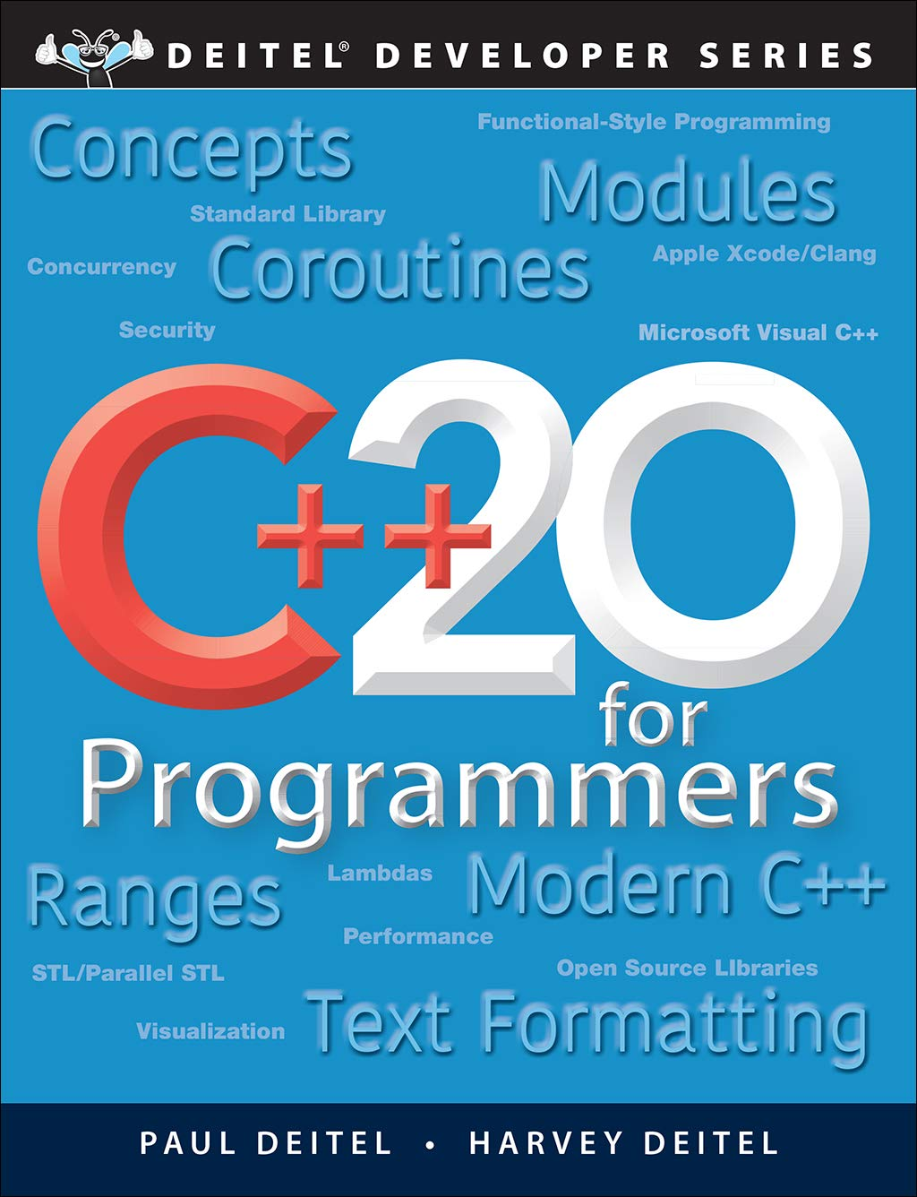
Books
  C++20 For Programmers: An Objects-Natural Approach

Slide 6
Dishonesty, Plagiarism in Quizzes, Assignments
All individuals involved in any kind of cheating in any exam, quiz, assignment or project will get -50% score.

Slide 7
Attendance
Students are required to attend 100% classes of courses registered and can not abstain from even a single class.
For circumstances beyond their control, students must apply for leave on prescribed Leave Application form.

Slide 8
Tentative Evaluation Breakdown
Assignments (8) | 10
Quizzes (10) | 10
Term Project (1) 2 Phases | 10
Midterm (1) | 30
Final (1) | 40
Total | 100

Slide 9
Course Execution
3 lectures of one hour every week
1 lab of three hours every week, CS112L
Mind it: Lecture scheduling is to be done by the Dir. (A&E). Please avoid visiting me for any clashes

Slide 10
Notes
Course contents and their order may be slightly modified during the course execution.
No make up for missed quizzes or assignments/homeworks
Deadline for assignments and projects are always final.
Quizzes may be announced or un-announced
Serious action will be taken for any kind of cheating
Visual Studio.Net (version yet to decide) will be used for GUI and console programming
All assignments and project will be on individual bases
Mid and Final exam of lab will be conducted on the IDE

Slide 11
Course Outline
Week 1 | User defined data types, Structures, Unions and Enumerations
Week 2 | Recursion, Preprocessing in C++
Week 3 | Bit Manipulation, Strings, Pointers
Week 4 | Reference and Dynamic memory allocation
Week 5 | Function Pointers, ADTs and C++ Classes-I
Week 6 | C++ Classes-II Constructor, Destructor, Copy Constructor
Week 7 | Inheritance, Virtual Functions and Polymorphism
Week 8 | Operator Overloading, Function and class templates
Week 9 | Exception Handling
Week 10 | I/O Streams and File Handling
Week 11 | Graphics
Week 12 | GUI Programming
Week 13 | Introduction to Standard Template Library
Week 14 | GUI

Slide 12

Motivation
Only 1 programming course out of approx. 40 courses
Core of core of computer science
Excellent Programming = Excellent chances of good job
Remember practice makes a person “perfect”.
  Same goes for programming.

Slide 13
Structure
A Structure is a container, it can hold a bunch of things.
  These things can be of any type.
Structures are used to organize related data (variables) into a nice neat package.

Slide 14
Structures

Slide 15
Structure
A Structure is a container, it can hold a bunch of things.
  These things can be of any type.
Structures are used to organize related data (variables) into a nice neat package.

Slide 16
Example - Student Record
Student Record:
  Name a string
  HW Grades an array of 3 doubles
  Test Grades an array of 2 doubles
  Final Average a double

Slide 17
Structure Members
Each thing in a structure is called member.
Each member has a name, a type and a value.
Names follow the rules for variable names.
Types can be any defined type.

Slide 18
Example Structure Definition
struct StudentRecord {
char *name; // student name
double hw[3]; // homework grades
double test[2]; // test grades
double ave; // final average
};

Slide 19
Using a struct
By defining a structure you create a new data type.
Once a struct is defined, you can create variables of the new type.
StudentRecord stu;

Slide 20
Accessing Members
You can treat the members of a struct just like variables.
You need to use the member access operator '.' (pronounced "dot"):
cout << stu.name << endl;
stu.hw[2] = 82.3;
stu.ave = total/100;

Slide 21

Structure Assignment
You can use structures just like variables:
StudentRecord s1,s2;
s1.name = "Joe Student";
…
s2 = s1;

Slide 22

Be Careful
If a member is a pointer, copying means copying the pointer (not what is pointed to).
"Joe Student"
name
hw
test
ave

Slide 23
Probably not what you want
StudentRecord s1,s2;
s1.name = "Joe Student";
…
s2 = s1;
s2.name = "Jane Doe";
// now s1.name and s2.name are both
// "Jane Doe"

Slide 24
Pointers to Structures
Pointers to structures are used often.
There is another member access operator used with pointers: ->
  StudentRecord *sptr;
  …
  cout << "Name is" << sptr->name;
  cout << "Ave is " << sptr->ave;

Slide 25
Other stuff you can do with a struct
You can also associate special functions with a structure (called member functions).
A C++ class is very similar to a structure, we will focus on classes.
  Classes can have (data) members
  Classes can have member functions.
  Classes can also hide some of the members (functions and data).

Slide 26
Structure Definitions
Structures
  Aggregate data types built using elements of other types
    struct Time {
    int hour;
    int minute;
    int second;
    };
  Members of the same structure must have unique names
  Two different structures may contain members of the same name
  Each structure definition must end with a semicolon
Structure tag
Structure members

Slide 27
Structure Definitions
Self-referential structure
  Contains a member that is a pointer to the same structure type
  Used for linked lists, queues, stacks and trees
struct
  Creates a new data type that is used to declare variables
  Structure variables are declared like variables of other types
  Example:
    Time timeObject, timeArray[ 10 ],
    *timePtr, &timeRef = timeObject;

Slide 28
Accessing Members of Structures
Member access operators:
  Dot operator (.) for structures and objects
  Arrow operator (->) for pointers
  Print member hour of timeObject:
      cout << timeObject.hour;
    OR
    timePtr = &timeObject;
    cout << timePtr->hour;
  timePtr->hour is the same as ( *timePtr ).hour
  Parentheses required: * has lower precedence than .

Slide 29
2. Create a struct data type
1 // Fig. 6.1: fig06_01.cpp
2 // Create a structure, set its members, and print it.
3 #include <iostream>
4
5 using std::cout;
6 using std::endl;
7
8 struct Time { // structure definition
9 int hour; // 0-23
10 int minute; // 0-59
Creates the user-defined structure type Time with three integer members: hour, minute and second.
11 int second; // 0-59
12 };
13
14 void printMilitary( const Time & ); // prototype
15 void printStandard( const Time & ); // prototype
16
17 int main()
18 {
19 Time dinnerTime; // variable of new type Time
20
21 // set members to valid values
22 dinnerTime.hour = 18;
23 dinnerTime.minute = 30;
24 dinnerTime.second = 0;
25
26 cout << "Dinner will be held at ";
27 printMilitary( dinnerTime );
Dinner will be held at 18:30 military time,
which is 6:30:00 PM standard time.
28 cout << " military time,\nwhich is ";
29 printStandard( dinnerTime );
30 cout << " standard time.\n";
31

Slide 30
32 // set members to invalid values
33 dinnerTime.hour = 29;
34 dinnerTime.minute = 73;
35
36 cout << "\nTime with invalid values: ";
37 printMilitary( dinnerTime );
Time with invalid values: 29:73
38 cout << endl;
39 return 0;
40 }
41
42 // Print the time in military format
43 void printMilitary( const Time &t )
44 {
45 cout << ( t.hour < 10 ? "0" : "" ) << t.hour << ":"
46 << ( t.minute < 10 ? "0" : "" ) << t.minute;
47 }
48
49 // Print the time in standard format
50 void printStandard( const Time &t )
51 {
52 cout << ( ( t.hour == 0 || t.hour == 12 ) ?
53 12 : t.hour % 12 )
54 << ":" << ( t.minute < 10 ? "0" : "" ) << t.minute
55 << ":" << ( t.second < 10 ? "0" : "" ) << t.second
56 << ( t.hour < 12 ? " AM" : " PM" );
57 }

Slide 31
Dinner will be held at 18:30 military time,
which is 6:30:00 PM standard time.
Time with invalid values: 29:73

Slide 32
Functions in Structures
We can also use functions in structures

Slide 33
Unions and Enumerations

Slide 34
Enumerated types
An enumeration is a “data type” in which labels for all possible values of the type can be listed
The type declaration consists of the keyword enum followed by the name of the new type and a block of code in which labels for all values of the type are listed
Syntax:
  enum NewTypeName {value1, value2, … , valueN};

Slide 35
Enumeration constants
The value labels listed in an enumeration are called enumeration constants
Enumeration constants must be valid C++ identifiers; they are not string or char literals
Enumeration constants are stored in memory as integers; by default, the first is assigned the value 0, the second 1, etc.
Thus the order of the listing determines the relative magnitude of enumeration constant values; the first is less than the second, which is less than the third, and so forth

Slide 36
Specifying different values in enumerations
By default, the first enumeration constant has the value 0, the second 1, the third 2, etc.
The default behavior can be overridden by assigning explicit values to one or more of the constants
The next several examples illustrate this option

Slide 37
Example 1 (enum)
The following enumeration uses explicit assignment to specify values for the symbols used in the Roman numeral system:
  enum RomanNum { I = 1, V = 5, X = 10, L = 50, C = 100, D = 500, M = 1000};

Slide 38
Example 2 (enum)
The following enumeration type creates constants that stand for the months of the year:
  enum MonthType {JAN=1, FEB, MAR, APR, MAY, JUN, JUL, AUG, SEP, OCT, NOV, DEC};
Only the first constant’s value is specified; since it is 1, the second is 2, the third is 3, and so on until the last (DEC) with the value 12

Slide 39
Using enumerated types
“Enumerations only create new data types”; to actually store and use values of the the new types, you must declare variables
Variables of each enum type can hold only those values specified by the enumeration
For example, with the MonthType enumeration, you could declare variables and assign them values like the following:
  MonthType thisMonth = APR;
  MonthType nextMonth = MAY;
  MonthType birthMonth = nextMonth;

Slide 40
Operations on enumerations
Since enumerations are not built-in data types, only some of the most common operations can be performed using variables of these types
The allowable operations include:
  logical comparison using the relational operators (<, >, <=, >=, ==, !=)
  simple arithmetic (but not arithmetic/assignment operations like ++ or --)
  enumerations can be parameters to, and/or return values from, functions
  enumerations can be used as switch expressions and/or case labels in switches – example on next slide

Slide 41
MonthType thisMonth;
…
switch ( thisMonth ) // using enum type switch expression
{
case JAN :
case FEB :
case MAR : cout << “Winter quarter” ;
break ;
case APR :
case MAY :
case JUN : cout << “Spring quarter” ;
break ;
case JUL :
case AUG :
case SEP : cout << “Summer quarter” ;
break ;
case OCT :
case NOV :
case DEC : cout << “Fall quarter” ;
}

Slide 42
Incrementing enum variables using type cast mechanism
The operators ++ and -- are not available for use with enum-type variables, as previously noted
However, enum-type variables can appear in mixed-type expressions with, for example, integers
This provides a mechanism for increment/decrement of enumeration type variables

Slide 43
Using enum type Control Variable with for Loop
MonthType month ;
for (month = JAN ; month <= DEC ; month = MonthType (month + 1 ) )
{ // uses type cast to increment
.
.
.
}

Slide 44
Simple arithmetic with enumeration constants
Previously, we defined an enumeration of the symbols used in the Roman numeral system
We will use this enumeration to illustrate arithmetic with enums, and see another example of type casting

Slide 45
Example
#include <iostream.h>
#include <stdlib.h>
enum RomanNum {I=1, V=5, X=10, L=50, C=100, M=1000};
int main()
{
cout << "Welcome to the world of Roman numerals!" << endl;
int num = (int)(M + C + L + X + V + I);
cout << "MCLXVI=" << num << endl;
num = (int)((L-X) + (V-I));
cout << "XLIV=" << num << endl;
system("PAUSE");
return 0;
}

Slide 46
Enumerated types and I/O
The insertion (<<) and extraction (>>) operators are not defined for enum-type variables
To perform input or output operations on user-defined types, you must provide your own functions
How will you do it? Any Suggestions?

Slide 47
Typedef
Definition:– a typedef is a way of renaming a type
E.g.,
    typedef struct motor Motor;
    Motor m, n;
    Motor *p, r[25];
    Motor function(const Motor m; …);

Slide 48
typedef
typedef may be used to rename any type
  Convenience in naming
  Clarifies purpose of the type
  Cleaner, more readable code
E.g.,
  typedef char *String;
E.g.,
  typedef int size_t;
  typedef long int32;

Slide 49
Unions
A union is like a struct, but only one of its members is stored, not all
    I.e., a single variable may hold different types at different times
    Storage is enough to hold largest member
    Members are overlaid on top of each other
E.g.,
  union {
  int ival;
  float fval;
  char *sval;
  } u;

Slide 50
Unions
It is programmer’s responsibility to keep track of which type is stored in a union at any given time!
E.g.,
  struct taggedItem {
  enum {iType, fType, cType} tag;
  union {
  int ival;
  float fval;
  char *sval;
  } u;
  };

Slide 51
Unions
It is programmer’s responsibility to keep track of which type is stored in a union at any given time!
E.g.,
  struct taggedItem {
  enum {iType, fType, cType} tag;
  union {
  int ival;
  float fval;
  char *sval;
  } u;
  };
Members of struct are:–
enum tag;
union u;
Value of tag says which member of u to use

Slide 52
Unions
unions are used much less frequently than structs — mostly
    in the inner details of operating system
    in device drivers
    in embedded systems where you have to access registers defined by the hardware

Slide 53
References
Book Code: A

Slide 54
References
Book Code: A

